Slide 1
MGCR 222 - Introduction to Organizational Behaviour
Chapter 12
Understanding Organizational Culture And Structure
Maya Sharma

Slide 2
Learning Outcomes
Defining Organizational Culture and its importance
Identify the three levels of culture and evaluate the roles they play in an organization
Define the four functions of culture within an organization
Discuss the origins of culture and the role of founders
Identify how to maintain an organizational culture

Slide 3
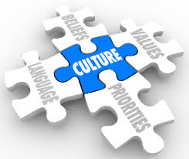
Organizational (Corporate) Culture
Is a shared understanding about accepted and valued behavior that acts as a (usually unwritten) guide for organizational members.
The “glue” that holds organizations together by providing cohesiveness and coherence among the parts.
Every organization has its own unique personality, just like people do.
Impact
What does it mean to you?

Slide 4
Understanding Organizational Culture
Shared among members
Disseminated by socialization
Organizational Culture
Influenced by its context and environment
Constantly evolving and adapting

Slide 5
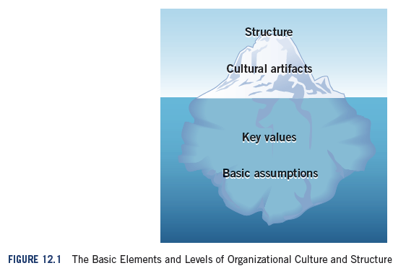
Categories of Culture Elements
Formal
Informal

Slide 6
3 Levels of Organizational Culture
Artifacts –symbols of
culture in the physical
and social work environment
Levels Of organizational Culture
Visible, may not be
decipherable
Values
Espoused: what members of
an organization say they value
Enacted: reflected in the way
individuals actually behave
Greater level
of awareness
Assumptions – deeply held
beliefs that guide behavior and tell
members of an organization how
to perceive and think about things
Taken for granted,
Invisible, Preconscious

Slide 7
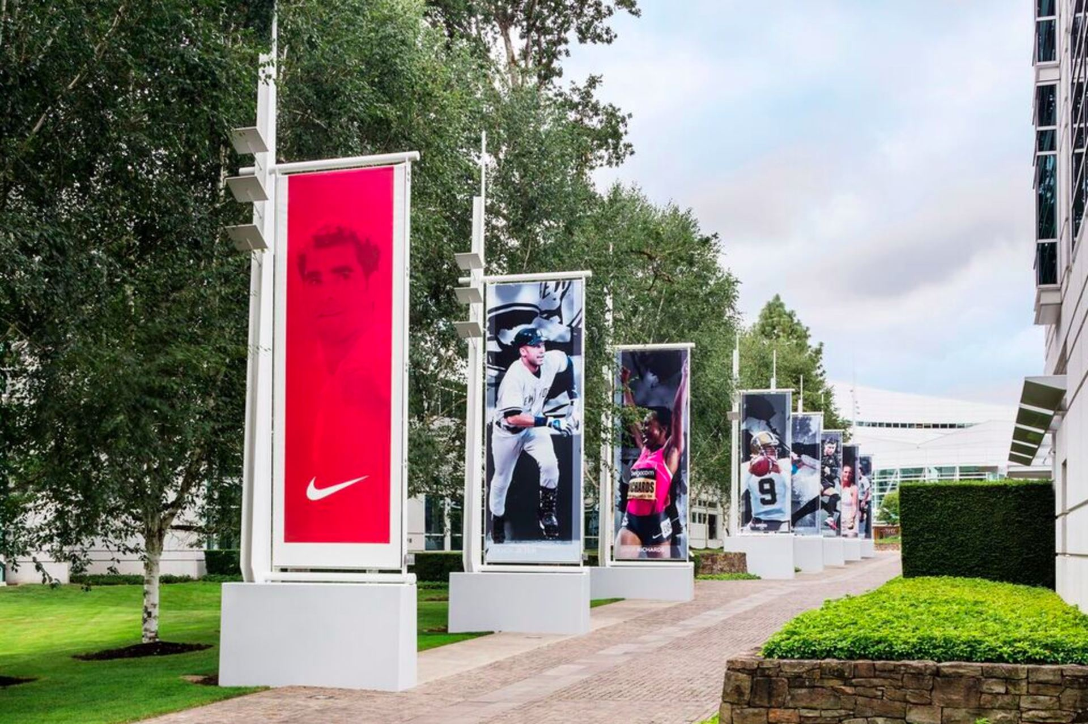
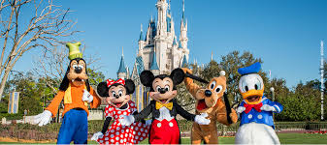
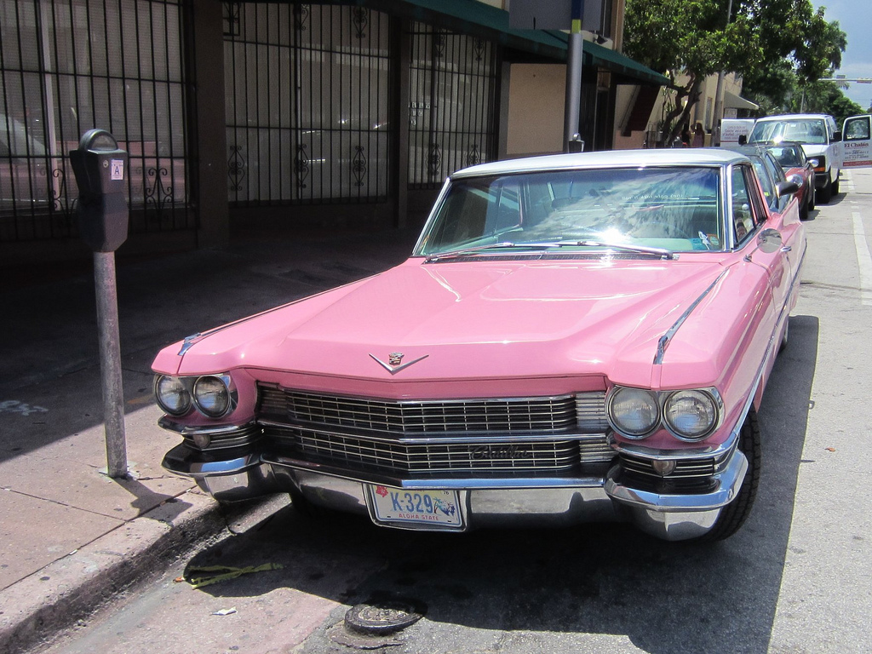
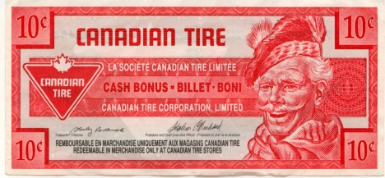
Cultural Artifacts
Personal Enactment: What people do
Ceremonies And Rites: Activities noting important occasions
Stories: What is retold
Rituals: Repetitive practices
Symbols: Unspoken messages

Slide 8
Values and Organizational Culture
Values
Family
Regional
National
Professional
Competing Values Framework (CVF): Two basic dimensions of culture :
Predictability versus adaptability.
External versus internal focus.

Slide 9
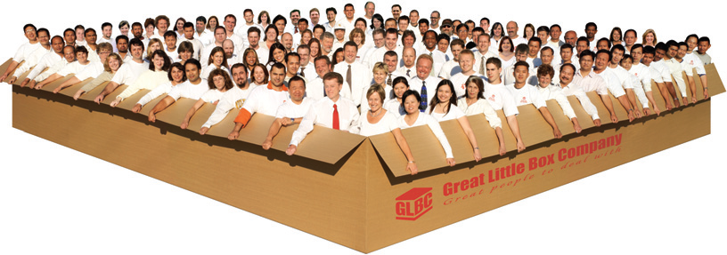
Functions of Organizational Culture
Culture provides a sense of identity to members and increases their commitment to the organization
Culture allows employees to interpret meaning of organizational events
Culture reinforces the values in the organization
Culture serves as a control mechanism for shaping behavior
Photo courtesy of The Great Little Box Company

Slide 10
Sustainable and Conventional Approaches to Culture
Conventional
Sustainable
Narrow Range Of Issues Being Considered
Self interests
Financial bottom line
Shareholders
Holistic Approach
Triple bottom line - financial, social, and ecological well-being,
Considering the interests of multiple stakeholders, and encouraging everyone to look out for others and not only for ourselves.
Ex: Southwest Airlines

Slide 11
Origins of Culture
Founder’s Values And Vision ex: Ben & Jerry’s
Shared Experiences And Success ex: Boeing
Industry, National And Societal Culture ex: Southwest Airlines

Slide 12
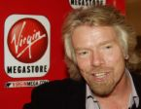
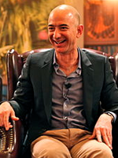

Function of Founders
Role Models Whose Values, Personality And Actions Reinforce Desired Organizational Culture
More likely to maintain long term profitability growth when Founder still involved
Front line obsession
Owner’s mindset

Slide 13
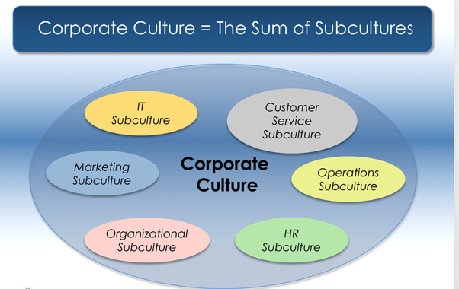
Subculture
Culture created within a subset of employees
Powerful norms
Employee fit influences satisfaction
Often function- based

Slide 14
How to Maintain an Organizational Culture
Recruitment and Selection: attracting and selecting people that support a value and cultural fit
Attrition: Misfits will leave due to incompatibility issues and their side effects.
Leadership Actions: send signals about the norms and values
Socialization: process through which new employees learn the attitudes, knowledge, skills, and behaviors required to function effectively within an organization.

Slide 15
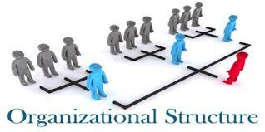
Organizational Structure

Slide 16
Learning Objectives
Identify the four fundamentals of organizational structure
Understand the impact of office design
Know the four types of departmentalization

Slide 17
Organizational Structure
Defines roles, tasks, functions, scope of authority and division of labour
How does it affect employees?
What people do
What skills they need in their position
With whom they interact
What information they have access to
Who they are accountable to
Is an artifact of culture that shapes experiences
Culture and structure influence each other
Structure is a framework for the culture to be implemented, while the culture dictates how the company should be structured.

Slide 18
Four Fundamentals of Organizational Structure
Standardization versus Experimentation
Specialization versus Sensitization
Centralization versus Dignification
Departmentalization versus Participation

Slide 19
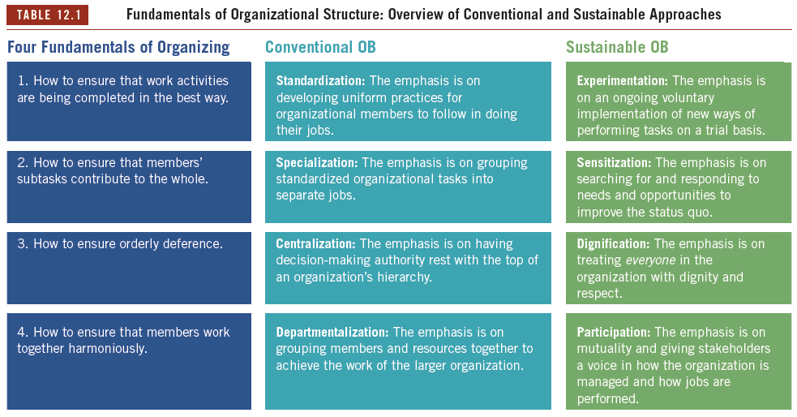

Slide 20
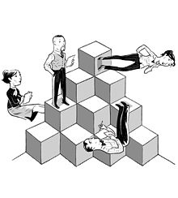
Four Types of Departmentalization
Functional
Specialization & Economies of Scale
Divisional
Product/Service/ Project
Region
Customer
Hybrid: 2 Types
Hybrid Functional & divisional
Matrix

Slide 21
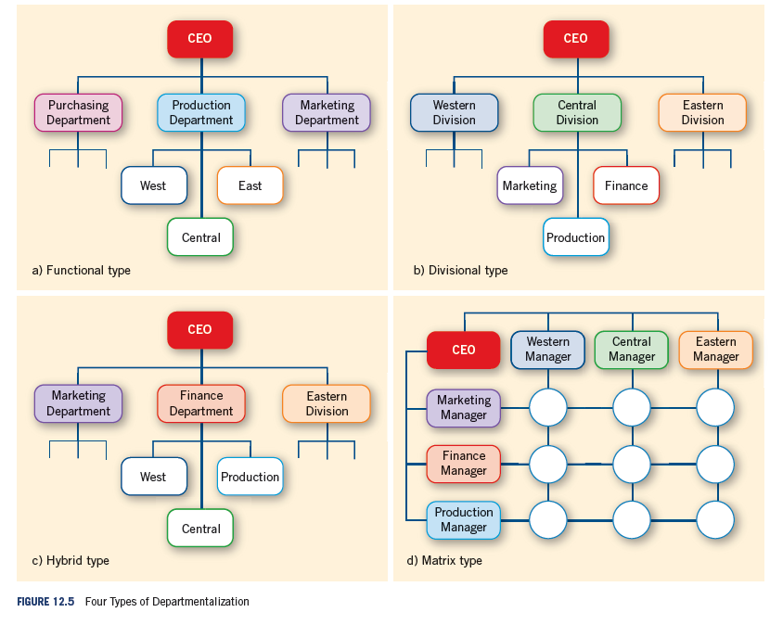
Notes:
LO4

Slide 22
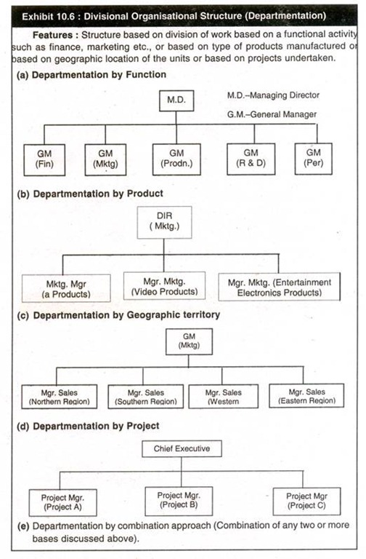
Examples of Divisional Structures

Slide 23
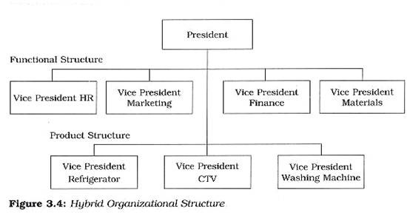
Hybrid Structure

Slide 24
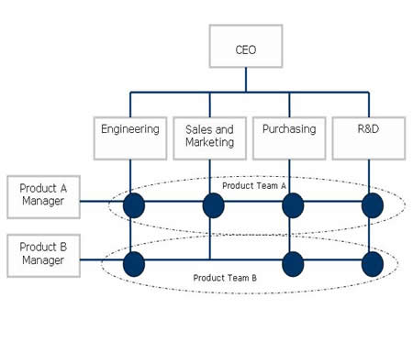
Matrix Structure

Slide 25
Contextual Variables Affecting Organizational Structure
Environment: The faster the environment changes, the more the structure must be flexible (i.e., decentralized authority)
Strategy & Goals: Different strategies require the use of different structures. A differentiation strategy needs a flexible structure, low cost may need a more formal structure
Skills of Human Capital: Highly skilled workers whose jobs require working in teams usually need a more flexible/adaptive structure
Complexity of Technology: The combination of skills, knowledge, tools, equipment, computers and machines used in the organization.
Complex technology requires a flexible structure (Small batch vs mass production)

Slide 26
Structural Design Concepts
Departmentalization
Height
Span of Control

Slide 27
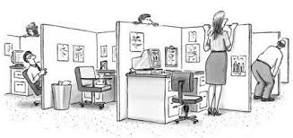
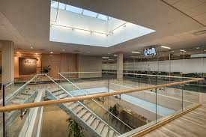
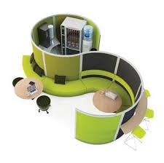
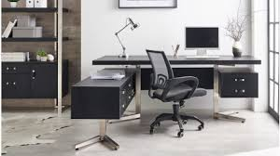


Slide 28
Key Terms
Authority
refers to the formal power given to specific members—usually managers—to arrange resources, assign tasks, and direct the activities of other members so as to achieve organizational goals.
Cultural stories
are the oral history of the critical events that have shaped an organization.
Centralization
is having decision-making authority rest with managers at the top of an organization’s hierarchy.
Cultural artifacts
provide tangible evidence of an organization’s values, and may include the organization’s physical features, shared stories, rituals, and formal structure and systems.
Delegation
is the process of giving authority to a person or group to make decisions in a specified sphere of activity.
Departmentalization
is grouping members and resources together to achieve the work of the larger organization.
Dignification
is the emphasis on treating everyone with dignity and respect in community.
Divisional
departmentalization occurs when members are placed together based on their working together as a subunit that provides a specific kind of products or services, serves similar customers, or works in the same geographic region.

Slide 29
Key Terms
Experimentation
is the emphasis on an ongoing voluntary implementation of new ways of performing tasks on a trial basis.
Functional
departmentalization occurs when members are placed into the same department based on having similar technical skills and using similar resources to perform their tasks.
Goal displacement
occurs when people get so focused on specific subgoals that they lose sight of more important overarching goals.
Hybrid
departmentalization occurs when an organization uses both functional structure and divisional structure.
Matrix
departmentalization is a type of hybrid structure in which members are simultaneously assigned to both functional and divisional departments.
Mutual discernment
is a process in which people deliberately learn from one another as they jointly address an issue.
Network structure
occurs when an organization enters fairly stable and complex relationships with a variety of other organizations that provide essential services, including manufacturing and distribution.

Slide 30
Key Terms
Organizational culture
is the set of shared assumptions, values, and experiences that influence the ways in which individuals, teams, and groups interact with one another and work toward company goals.
Organizational structure
is the formal arrangements and linkages among members and groups that specify work activities and subtasks and allow them to be completed.
Participation
is the emphasis on mutual discernment and giving stakeholders a voice in how the organization is managed and how jobs are performed.
Rituals
are behavioural practices that perpetuate, reinforce, and keep alive a particular value that defines an organization.
Shared stories
are well-known narrative accounts that form the oral history of critical events that have shaped an organization.
Sensitization
is the emphasis on searching for and being receptive to better ways of doing things in order to take advantage of existing opportunities or address existing needs.
Span of control
is the number of members a given manager has authority over.
Specialization
refers to grouping standardized organizational tasks into separate jobs
Standardization
is developing uniform practices for organizational members to follow in doing their jobs.
Virtual organization
is one in which members come and go on an “as-needed” basis, and who are networked together with an information technology architecture that enables them to synchronize their activities

Slide 31
Next Week
Guest Speakers- attendance is mandatory and a technology ban is in effect.
Benoit Grenier Vice President Human Resources and Organizational Development, Enerkem
Peg Brunelle, Career Services McGill
Please take notes- the content of the presentations may be on the final exam
Participation marks in effect during the sessions (loss if using laptops or cell phones)

